Slide 1
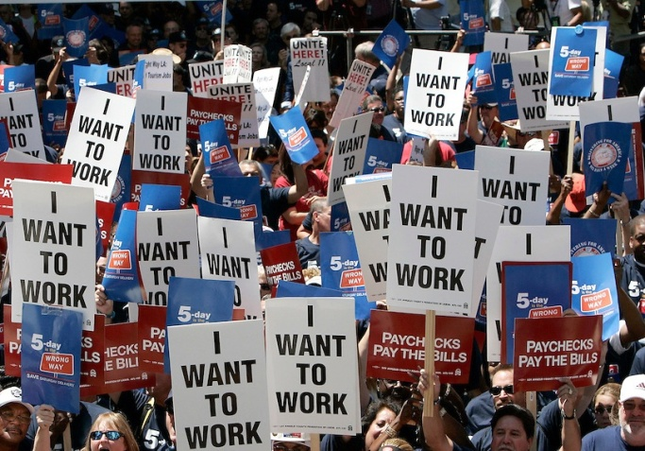
The Georgia FairTax Act of 2016
Who is
Georgians for Fair Taxation?
Non-partisan, non-profit GA corp.
31,000 contact email list in GA.

Slide 2
What’s the Goal?
Greater economic & job growth
by taxing consumption
rather than income.
The Georgia FairTax Act of 2016

Slide 3
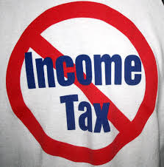
Key Features
Completely eliminates GA state income tax.
Taxes retail purchases of new items and services at 5.4%
Rebates tax paid on necessities (the “prebate”).
The Georgia FairTax Act of 2016

Slide 4
Who came up with the plan?
Written by an author of Federal FairTax Act.
Beacon Hill Institute modeled GA Dept of Revenue data.
Reviewed by Fiscal Policy Institute at GSU.
The Georgia FairTax Act of 2016

Slide 5
Won’t it make State Revenue more Volatile?
NO! Income tax is more volatile 10 years running.
8.9%/year*
7.1%/year*
Income Tax Volatility
Sales Tax Volatility
*Avg annual change based on GA Dept of Revenue 2005 – 2014 as reported to US Census Bureau.
The Georgia FairTax Act of 2016

Slide 6
Won’t the State Lose Revenue?
NO! Tax base, rates set to produce revenue equal to current amount.
The Georgia FairTax Act of 2016

Slide 7
Won’t it hurt the poor?
NO! Prebate reimburses households for tax paid on necessities.
Jobs are best cure for poverty. Bill encourages employment.
The Georgia FairTax Act of 2016

Slide 8
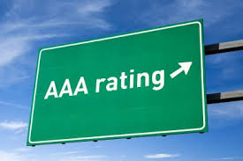
Will it hurt Georgia’s Bond Rating?
NO! States with no income tax have AAA bond ratings.
Economic growth helps the bond rating.
GA fell to 39th place under the current tax code.*
*2016 State Business Climate Index, Tax Foundation
The Georgia FairTax Act of 2016

